Slide 1
Old Testament Survey
Why jonah is a book of mission
By Jose Guerra 3 Nov 2016
Church History Team - 0verseer: Pastor Ray Poutney

Slide 2
Trivia
James Bartley (1870 – 1909)
Famous for being swallowed by a whale and living circa the 1890s
Survive inside a whale for 18 hours
When freed his skin was bleached and he was blind
Lived for another 43 years

Slide 3
Who was Jonah
He was a prophet from Gath-Hepher, the son of Amittai
Active during the reign of the second King Jeroboam
He was commanded by God to go to the city of Nineveh to prophesy against its wickedness

Slide 4
The City of Nineveh
It was the capital of the Assyrian Empire
They were an idolatrous nation
Proud and ruthless
Bent on World conquest
Had long been a threat to Israel

Slide 5
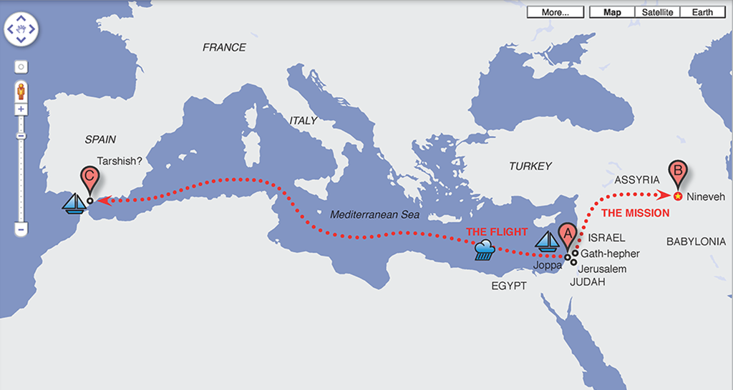
Jonah’s travel

