Slide 1
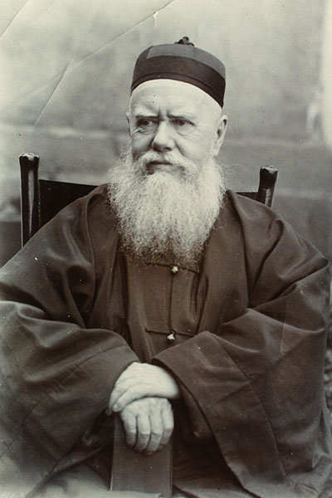
James Hudson Taylor
1832 to 1905
21 July 2016

Slide 2
Christianity in China Today
China once tried to destroy Christianity in the country
Today it is trying to control Christianity:
By creating a Chinese version of Christiantiy
State run churches which are overlooked by the government
18 yr olds and older are only permitted to join officially sanctioned Christian groups registered with the government
Encouraging local communist control of Christian groups
The Chinese government runs 3 official churches:
Three-self Church
China Christian Council
Chinese Patriotic Catholic Church
The Chinese government does not protect Christian rights

Slide 3
Christianity in Chinese History
The earliest Chinese religions included:
Taoism
Buddhism
Confucianism
Christianity dates back to the 7th century (635 AD)
The earliest Christians were monks which were allowed to preach upon arrival in the Tang Dynasty
In 845 AD at the height of the Buddhist persecution emperor Wuzong banned Buddhism, Christianity and Zoroastrianism
In 986 AD a monk reported to the Patriarch of the East:
“Christianity is extinct in China; the native Christians have perished in one way or another; the church has been destroyed and there is only one Christian left in the land.”

Slide 4
Christianity and the Mongol Influence
In the 13th centaury the Mongol Empire setup the Yuan Dynasty in China
They had the largest empire in the World, stretched from the far East to the borders of Eastern Europe
The Mongols were heavily influenced by Christianity
Many Mongol tribes were Nestorian Christians as were many of Genghis Khan’s descendants
The Mongols worked closely with Western Christian missionaries and communicated directly with the Papacy

Slide 5
High Competition
The rise of Islam and the spread of Catholicism brought an end to the Nestorian Christians
By the time of the Ming Dynasty 14th centaury (1368-1644 AD) many early forms of Christianity were banned as well as Buddhism, but Islam and Judaism were not because they were compatible with Confucianism
By the mid-16th centaury Christianity appears to have gone extinct again

Slide 6
Missionary work in China
By the 16th centaury European ships make contact with China and begin trade
This begins a wave of missionaries into China and various forms of Christianity are established again
Russian Orthodoxy was introduced in 1715
Protestantism entered China in 1807
After which various Chinese Emperors began to oppose Christianity

Slide 7
Christian Conflicts in China
Near the end of the Qing Dynasty (1644-1912) Emperors were opposed to their Manchu people converting to Christianity
In 1850 a civil war erupted between the Qing government and the Christian millenarian movement called the Taiping Civil War (1850-1864)
The civil war started because the government persecuted a Christian sect known as the “God Worshiping Society” led by Hong Xiuquan
He believed he was the younger brother of Jesus Christ

Slide 8
James Hudson Taylor
He ran away from his Methodist background as a young man but became born again at 17 in 1849.
He quickly vowed to become a missionary in China, which he visited 11 times.
In preparation for the work he learned Hebrew, Greek. Latin, Mandarin. Chaozhou and translated the NT into a local dialect Wu.
He also studied medical skills and eventually became qualified in midwifery.
He formed the Chinese Inland Mission (CIM) which became the Overseas Missionary Fellowship (OMF) International in 1964.
He accepted any qualified missionaries of any Protestant denomination, including women.
He and his fellow missionaries conformed to the Chinese cultural dress and appearance, including the women.
There was a riot in Yangzhou, which resulted in the destruction of his station there by fire. The British Parliament accused him of starting a war.

Slide 9
His Legacy
He spent 51 years in China and his legacy includes sending over 800 missionaries to inland China who began 125 schools. These fellows founded and made 18,000 direct converts.
He also established more than 300 missionary stations with more than 500 local helpers in all 18 provinces.
His insistence on living by faith by himself and his colleagues greatly influenced the Protestant churches, along with his tireless campaigning has resulted in the CIM to become the largest Protestant missionary agency in the world.

Slide 10
His Losses
The CIM suffered more than any other Chinese mission (58 missionaries and 21 children were killed).
His first wife and all their children died in China.
He was practically paralysed by a fall for a period and suffered many bouts of ill heath, forcing to return to England on occasion to recuperate.
He was nearly shipwrecked 3 times.

Slide 11
Questions

