Slide 1
Old Testament Survey
From creation to abraham
Part 2
16 June 2016

Slide 2
The Five Covenants
The Adamic Covenant
The Noahic Covenant
The Abrahamic Covenant
The Mosaic Covenant
The Davidic Covenant
The New Covenant

Slide 3
General Overview
The Creation
From Creation to Noah
From Noah to Abraham
Three key points:
The Mission
The Blood of the Innocent (sacrifices)
The Covenant

Slide 4
Review Genesis 4 through 9 Summary
Gen 4 Cain and Able’s story
Gen 5 the genealogy of Adam to Noah
Gen 6 the earth was corrupt
Gen 7 the Great Flood
Gen 8 the waters recede
Gen 9 the Covenant with Noah

Slide 5
The Three Key Points
The Mission
God interacts directly with Adams descendants
God takes Enoch with him
God sends direct commands to Noah
The Sacrifice
Noah sacrifices some of the clean animals and clean birds as burnt offerings Gen 8:20
The Covenant
Gen 9:1-17 God makes a covenant with Noah, his descendants and all the animals on the earth.

Slide 8
Summary from Noah to Abraham
Noah (Gen 9:20-24)
Ham, Shem and Japheth (Gen 9:25-27)
Nimrod (Gen 10:9-10)
Babel (Gen 10:25; 11:1-9)
Terah (Gen 11:25-32)
Abram and Lot (Gen 12:1-8)

Slide 9
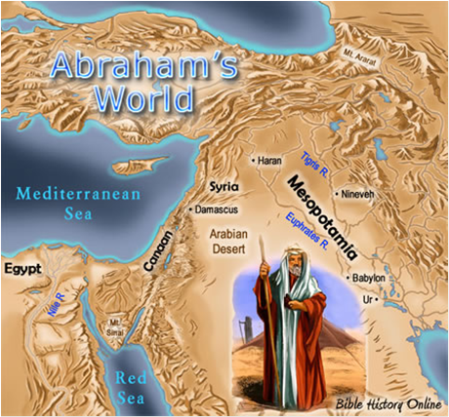

Slide 10
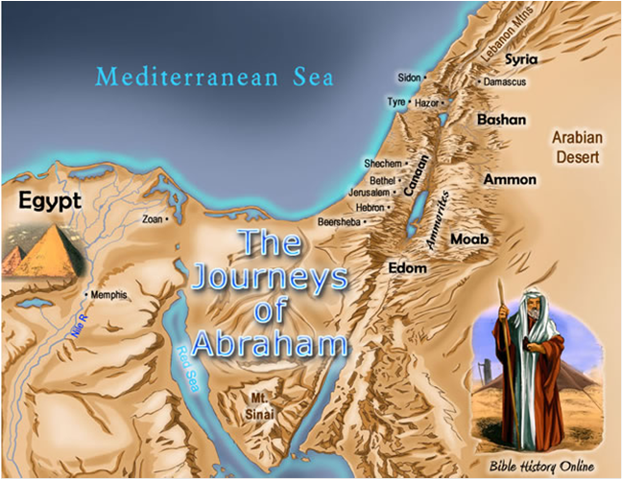

Slide 11
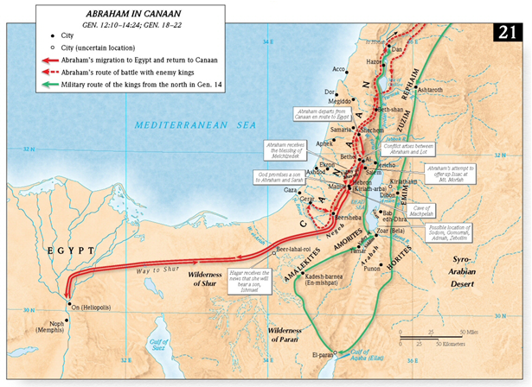

Slide 12
Summary from Noah to Abraham
Resolution between Abram and Lot (Gen 13:4-13)
God promises all of Canaan to Abram and his descendents (Gen 13:14-17)
Abram relocates to the plains of Mamre (Gen 13:18)
War (Gen 14:1-16)
Melchizedek of Salem (Gen 14:11-24)
God’s promise of an heir (Gen 15:1-6)
God’s re-iteration of His promise of the land (Gen 15:7-21)
Sarai and Hagar (Gen 16)
*God confirms His promises (Gen 17)
Abraham entertains 3 men (promise of heir re-iterated) (Gen 18:1-15)
Abraham intercedes for Sodom and Gomorrah (Gen 18:16-33)

Slide 13
Summary from Noah to Abraham
The escape of Lot and his 2 daughters (Gen 19:1-28)
Lot's daughters sleep with him (Gen 19:29-38)
Abraham’s journey through Gerar (Gen 20)
Sarah gives birth to Issac (Gen 21:1-8)
Hagar and Ismail are banished (Gen 21:9-21)
*Abraham and Abimelech make a covenant at Beersheba (Gen 21:22-34)
*God commands Abraham to sacrifice Issac (Gen 22:1-18)
Sarah buried at Hebron (Gen 23)
Abraham sends Issac to search for a wife (Gen 24)
Abraham remarries and dies (Gen 25:1-11)

Slide 14
Summary from Noah to Abraham
Gen 10 is a genealogy of descendants
Gen 11 Towel of Babel and genealogy of Shem
Gen 12 The Covenant (God calls Abram)
Gen 13 Abram and Lot part ways (God reiterates promise verse 14)
Gen 14 Nine kings go to war, Lot captured then rescued
Gen 15 The ritual/sacrifice in a vision
Gen 16 Hagar and Ishmael
Gen 17 The sign of the Covenant (Circumcision)

Slide 15
The Abrahamic Covenant
He will be made into a great nation (Gen 12:2)
This nation will be led into the Promised land (Gen 12:1)
Through him (Abraham) all people of the earth will be blessed (Gen 12:3)

Slide 16
The Three Key Points
The Mission
God interacts directly with Abram
Appears in visions
Talks to him/commands him
The Sacrifice
The sacrifice of the animals in Gen 15
The Covenant
Gen 12 the covenant is made
Gen 17 the sign of the covenant

