Slide 1
Old Testament Survey
From abraham to Moses
Part 3
7 July 2016

Slide 2
The Five Covenants
The Adamic Covenant
The Noahic Covenant
The Abrahamic Covenant
The Mosaic Covenant
The Davidic Covenant
The New Covenant

Slide 3
General Overview
The Creation
From Creation to Noah
From Noah to Abraham
Three key points:
The Mission
The Blood of the Innocent (sacrifices)
The Covenant

Slide 4
Review of the Three Covenants
The Adamic Covenant can be thought of in two parts:
Edenic Covenant (Gen 1:20-30, Gen 2:16-17)
Mankind (male and female) created in God’s image.
Mankind’s dominion (rule) over the animal kingdom.
Divine directive for mankind to reproduce and inhabit the entire Earth.
Mankind to be vegetarian (eating of meat established in the Noahic covenant: Genesis 9:3).
Eating the fruit of the tree of the knowledge of good and evil forbidden (with death as the stated penalty).
Adamic Covenant (Gen 3:16-19)
Enmity between Satan and Eve and her descendants.
Painful childbirth for women.
Marital strife.
The soil cursed.
Introduction of thorns and thistles.
Survival to be a struggle.
Death introduced.
Death will be the inescapable fate of all living things.
Promise of Grace (Gen 3:15 the “Proto-Gospel or First Gospel”)
"And I will put enmity between you and the woman, / And between your seed and her seed; / He shall bruise you on the head, / And you shall bruise him on the heel."

Slide 5
The Three Key Points
The Mission
God interacts directly with Adams and Eve
God commands them not to eat of the tree of good and evil
The Sacrifice
God sacrifices animals and makes cloths for them
The Covenant
Gen 3:15-19 listed on the previous slide

Slide 6
Review of the Three Covenants
Noahic Covenant (Gen 9:1-17)
Noah and his family are commanded to fill the earth
Mankind is giving dominion over the animals
People are not allowed to kill people
No more Great Floods
The rainbow is the sign of the Covenant

Slide 7
The Three Key Points
The Mission
God interacts directly with Adams descendants
God takes Enoch with him
God sends direct commands to Noah
The Sacrifice
Noah sacrifices some of the clean animals and clean birds as burnt offerings Gen 8:20
The Covenant
Gen 9:1-17 God makes a covenant with Noah, his descendants and all the animals on the earth.

Slide 8
Review of the Three Covenants
Abrahamic Covenant (Gen 12:1-3)
Abraham will be made into a great nation (Gen 12:2)
This nation will be led into the Promised land (Gen 12:1)
Through him (Abraham) all people of the earth will be blessed (Gen 12:3)

Slide 9
The Three Key Points
The Mission
God interacts directly with Abram
Appears in visions
Talks to him/commands him
The Sacrifice
The sacrifice of the animals in Gen 15 in a dream or vision
The Covenant
Gen 12 the covenant is made
Gen 17 the sign of the covenant

Slide 10
The Fourth Covenant
Mosaic Covenant
A conditional covenant between God and the nation of Israel (Ex 19-24)
The people of Israel had to be obedient to the Law (Ex 19:5)
The people of Israel agree to the covenant (Ex 19:8)
Israel became God’s chosen people
Promised to make Israel a “Kingdom of Priests and a holy nation”

Slide 11
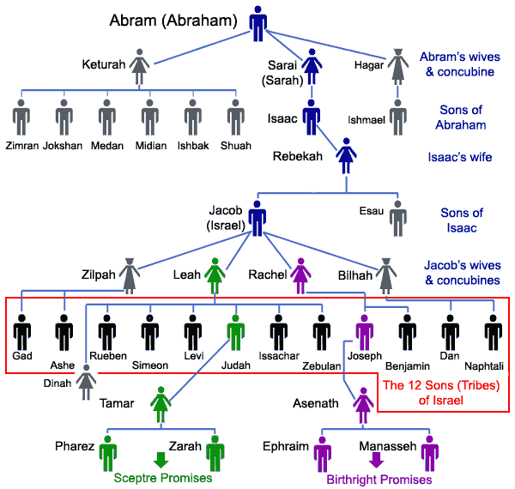

Slide 12
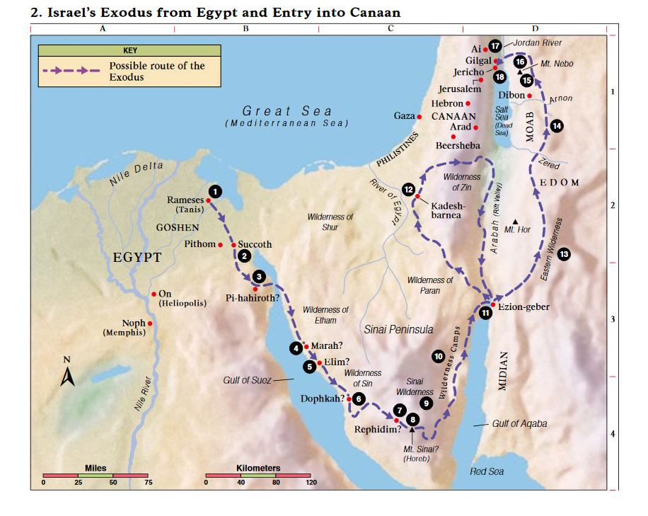

Slide 13
Questions

