Slide 1
The Biblical Foundations for Mission
A book on mission
By Jose Guerra 10 Nov 2016
Church History Team - 0verseer: Pastor Ray Poutney

Slide 2
Answers to Romans 9:13
Romans 9:13 - As it is written, “Jacob I loved, but Esau I hated.” (ESV)
Malachi 1:2-3 – “Yet I have loved Jacob 3 but Esau I have hated. I have laid waste his hill country and left his heritage to jackals of the desert.” (ESV)
Passage refers to the Elect and non-elect (Edomites) not the individuals
Interpreting the word “Hate”
  The Hebrew word for “Hate” interprets to “Loved Less”
  The Hebrew word actually means “Hate”
Further Reading:
  https://gotquestions.org/Jacob-Esau-love-hate.html
  http://www.toughquestionsanswered.org/2009/05/25/does-god-really-hate-esau/
  https://redeeminggod.com/god-love-jacob-and-hate-esau/

Slide 3
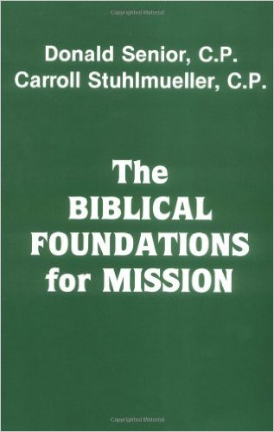
Source Material

Slide 4
How is the Book Divided?
Part 1 – The Foundations for Mission in the Old Testament
  Look at themes in the Old Testament for mission
Part 2 – The Foundations for Mission in the New Testament
  Look at individuals books of the New Testament for mission
Part 3 – Conclusion
  Summarizes the results and considers implications for contemporary theology and church life

Slide 5
Critical Thinking Question
If the Church has a universal gospel, how can the church become a universal church?

Slide 6
Quote of the Day
“The gospel comes in the person and message of the missionary as a free and respectful invitation. The gospel-bearer must be aware that he or she is not the proprietor of all truth but bears a gift of God’s salvation that, in many ways, the non-Christian has already experienced.”

Slide 7
Defining Mission
Missionary activity involves more than just “making converts”…
Mission – the God-given call to appreciate and share one’s religious experiences and insights, first within one’s own community and tradition, and then with people and communities of other cultural, social and religious traditions.
Mission is two-way:
  Faith is shared but not imposed
  The missionary will be instructed and enriched by discovering God’s salvation already at work in the people and culture to whom he is sent

Slide 8
Critical examples to consider
The Lord’s love for Israel also summons Israel to the herem, or holy war. Deuteronomy, chapter 7:
“When the Lord your God brings you into the land which you are entering to take possession of it, and clears away many nations before you, … you must utterly destroy them; you shall make no covenant with them, and show no mercy to them” (7:1-2)
How can a policy of mission be detected within these lines of ardent exlusivism and even of violent repudiation of the foreigner?
Israel is considered the elect people and all other nations non-elect.

Slide 9
Critical examples to consider
If a nation entered into a favourable treaties with Israel, then they were grouped in the category of “the descendants of Japheth” in the table of nations Gen 9-10 and a particular blessing was invoked over them.
If they were drawn into competitive contact with Israel they were classified under the “descendants of Ham” and a curse was levelled against them.

Slide 10
Internal vs External focus
The authors state that at first glance the Old Testament appears to have it’s central focus on one elect people (nation)
However, upon a closer examination of the Old Testament, we can see an external radiation from a central focus of one nation to that of all nations

Slide 11
A Signal of Universal Salvation
In Genesis 10 the ancestors of Israel were not separated from other people; they were indistinguishable
Yet from Gen 10 into 11 we find within the lineage of Arpachshad the name of “Terah…the father of Abram”.
In origin, Israel was no different from any other Gentile people. (Ref. Ezek. 16:3)

Slide 12
Anyone can be Chosen
If Arpachshad can be the progenitor of a chosen people, why could God not chose someone else?
God can raise up a new chosen people from other, least likely candidates in the days of John the Baptist…
“from these [seemingly lifeless] stones” Lk. 3:8

Slide 13
Mission in the Bible
The entire Bible, not just the NT, lays the foundations for mission.
God is Savior before Creator

