Slide 1
Church History
The Christian middle ages (590 – 1517 ad)
By Jose Guerra 29 Sept 2016
Church History Team - 0verseer: Pastor Ray Poutney

Slide 2
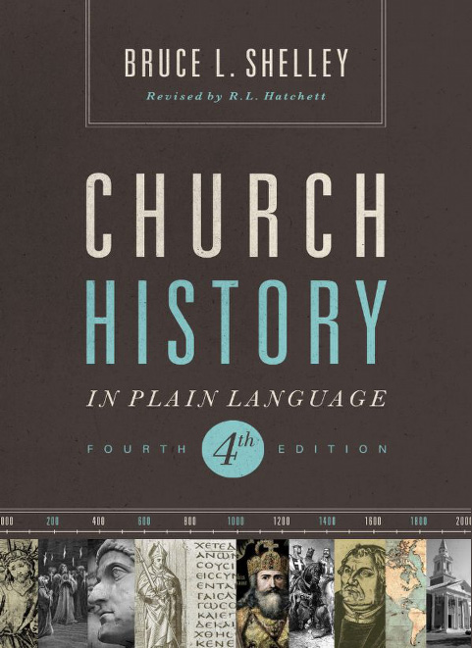
Primary Source Material

Slide 3
Agenda
Hand out outlines
Define the lesson timeline for the session
Review Resource page on EHBC website
The Christian Middle Ages

Slide 5
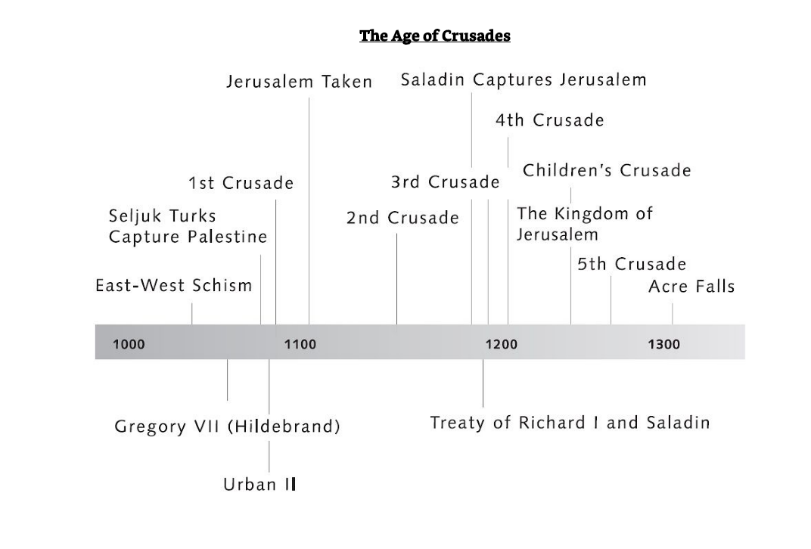

Slide 6
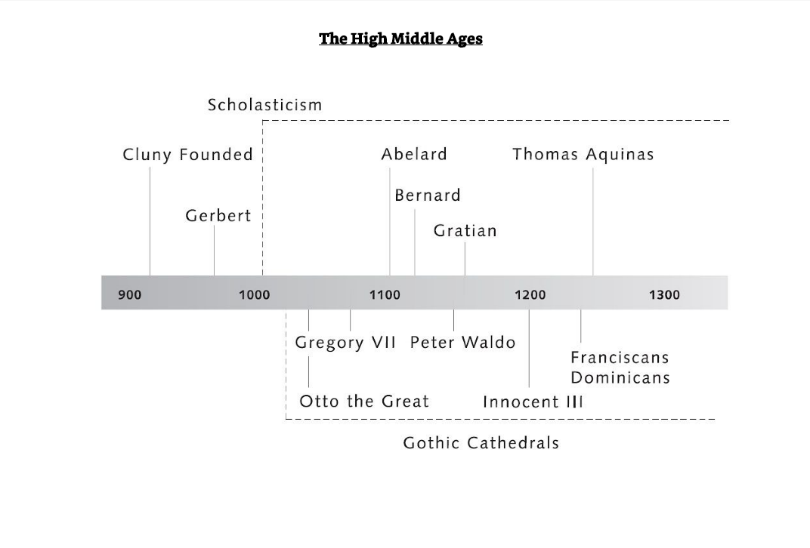

Slide 7
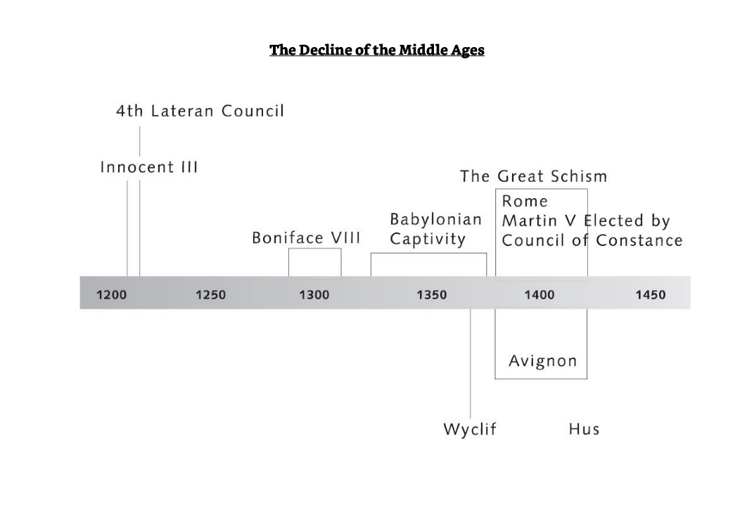

Slide 8
Quote of the Day
“Europe owes more to the Christian faith than most people realize. When the barbarians destroyed the Roman Empire in the West, it was the Christian church that put together a new order called Europe.”
Shelley, Dr. Bruce L.. Church History in Plain Language: Fourth Edition (p. 171). Thomas Nelson. Kindle Edition.

Slide 9
Last Week in Church History
The rise and fall of the Christian Roman Empire
Started when Constantine converted to Christianity
Two types of Christians:
Those true to the faith
Those who used the faith for personal and political gain (paper thin faith, secularism, the merging of pagan practices)
Roman Emperor power declined as Bishops power increased
The birth of the papacy and the first Pope (Bishop Leo)
The fall of the Christian Roman Empire to Barbarians

Slide 10
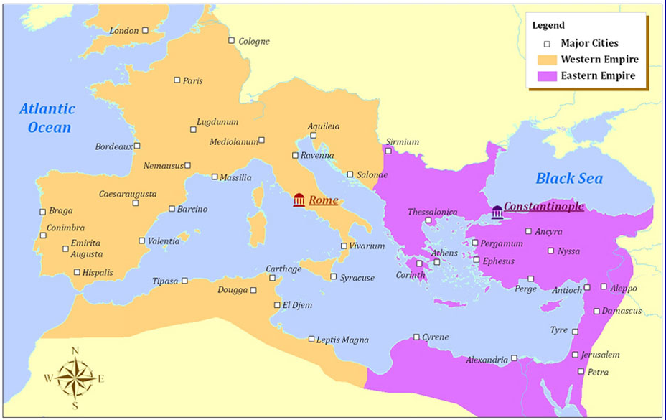
*Image from http://explorethemed.com/fallrome.asp?c=1

Slide 11
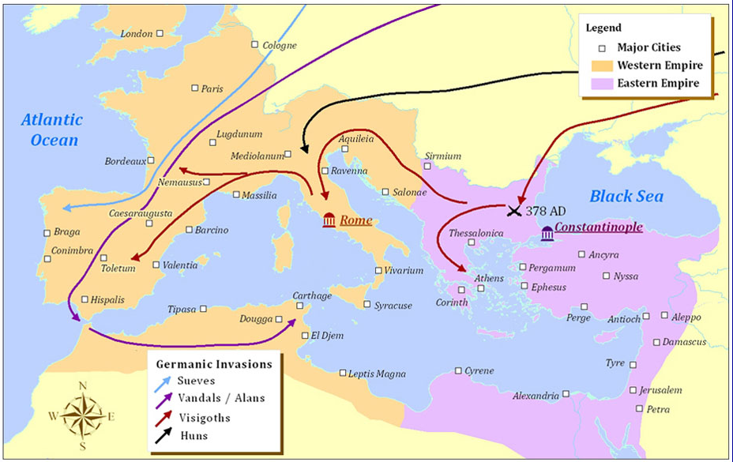
*Image from http://explorethemed.com/fallrome.asp?c=1

Slide 12
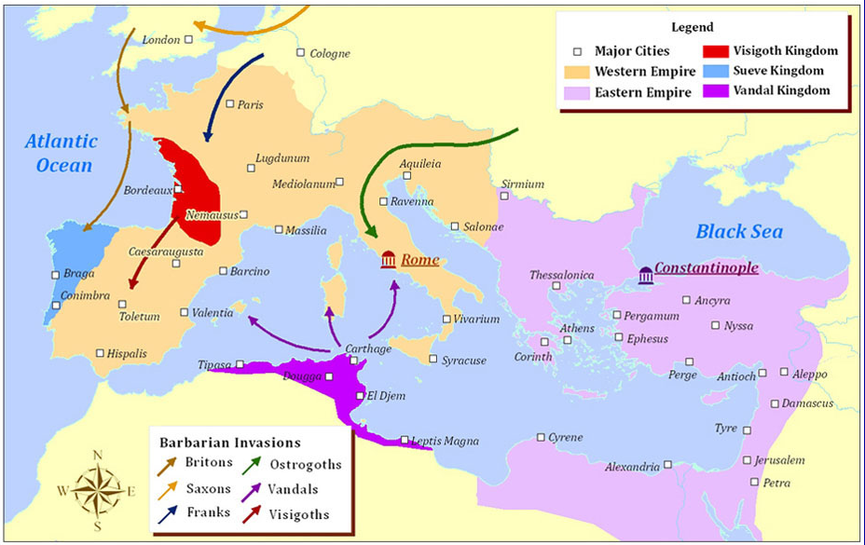
*Image from http://explorethemed.com/fallrome.asp?c=1

Slide 13
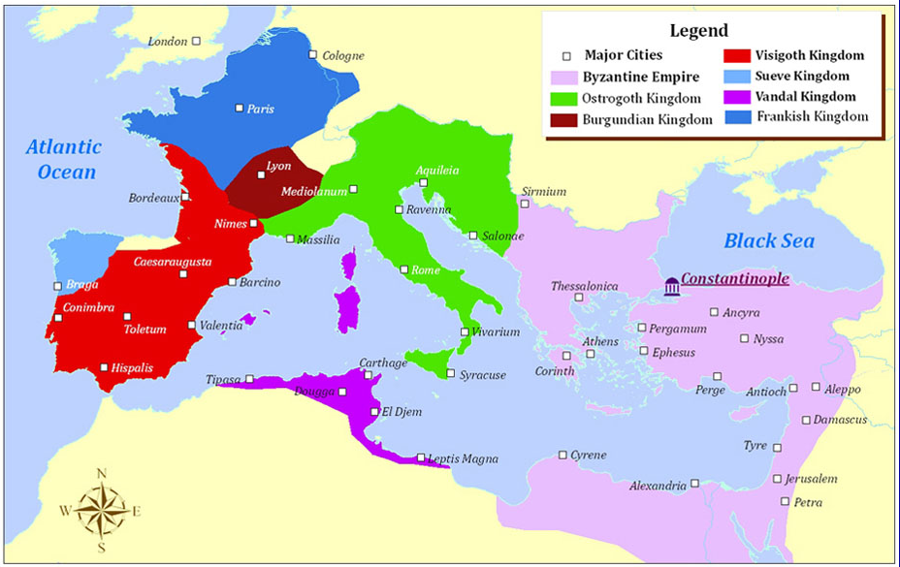
*Image from http://explorethemed.com/fallrome.asp?c=1

Slide 14
God abandons the Christian Roman Empire?
In the 530’s there were fumes in the air, sunlight but little heat and a great famine
The 540’s saw an outbreak of Bubonic Plague killing tens of millions around the known World
In July 551 the eastern Mediterranean was rocked by the Beirut earthquake, which triggered a tsunami. The combined fatalities of both events probably exceeded 30,000, with tremors being felt from Antioch to Alexandria.

Slide 15
Reign of the Popes Key figures & Events
Bishop Leo (Pope Leo I or Leo the Great: 440 – 461)
Gregory the Great (590 – 604)
Pope Leo III (795 – 816) & Charlemagne (birth of Christendom)
Death of Charlemagne gave rise to feudalism
Feudalism led to Emperors having power over the church
Revival in Benedictine order of Cluny cleansed corruption from the church and raised the power of the Pope
1059 Cluniac reformers created the College of Cardinals which henceforth elected the popes
Gregory VII (1073– 1085) claimed unprecedented power for the papacy
Pope Urban II (1088 – 1099) launched the First Crusade in 1095
Pope Innocent III (1198– 1216), a new type of administrator-pope
The Great Papal Schism (1378 – 1417)

Slide 16
Gregory the Great (b. 540 to d. 600)
Born in 540 from an old and wealthy senatorial family and was educated for government
He was a devout Christian
Became the Mayor of Rome and brought much reform
When his father died he used his family wealth the feed the poor, setup monasteries, and lived a monastic lifestyle
Pope Pelagius II died of plague and Gregory was elected Pope (he ran away and was dragged back to Rome)
He was a monastic Pope, lived a simple life (did not believe in titles)
Defended Rome and reformed it
Negotiated with Barbarians and established the Pope as a powerful Political leader greater than the emperor
He emphasised many of today’s Catholic beliefs (repentance, penance, prayer throughout the day, praying to the Saints, the power of holy relics, baptism, meritorious works, the power of the Eucharist)
He established ritual

Slide 17
Charlemagne and Christendom
King of the Franks
Conquered most of Europe
He brought order to a chaotic Europe
In 800 became first “Holy Roman Emperor”
With the Pope Leo III he created Christendom
Strong advocate of education and required that monasteries have schools to teach (singing, grammar, arithmetic)
He extended Christian civilization in Europe

Slide 18
The Rise of Islam
Mohammad is born in 570
Meditates in a cave and is visited by an angel which tells him to recite (birth of the Koran)
He slowly gained followers
After several battles, arguments and wars he gained a large following in Arabia
In the first 100 years numerous capitals fell to Islam: Jerusalem, Damascus and Cairo
His death in 632 started the Sunnis and Shiites divisive issue of succession

Slide 19
The Holy Crusades “God Wills It”
There were several Crusades led by several powerful Popes
The first Crusade was the most successful, it reclaimed the Holy Lands (Jerusalem)
Led primarily by nobles
People fighting for Christendom and for forgiveness of sins
Later crusades were led by corrupt Popes and were less successful

Slide 20
East-West Schism (1054)
Divisions between East and West began long before 1054 with the Ecumenical councils
In 1053 the Patriarch of Constantinople ordered the closure of all Latin churches in Constantinople
Rome in turn required Greek churches in Southern Italy to either close or conform to Latin practices
Key issues for the division:
The source of the Holy Spirit (Theological differences-modalism)
The use of leavened vs unleavened bread for the Eucharist
The claim’s of the Pope in Rome to universal jurisdiction
Ecclesiastical differences (community vs one head of church)
Icons (not creations of men but manifestations of heavenly ideal)

Slide 21
Scholasticism
The birth of Universities, schools and school masters
First schools taught about understanding the scriptures
This led to free thinking of educated men
The rediscovery of Aristotle's writings further expanding questioning of the church and papacy
These were the seeds which led to the Reformation years later

