Slide 1
Church History
The church of England reformation
By Robert Morris 6 Oct 2016
Church History Team - 0verseer: Pastor Ray Poutney

Slide 2
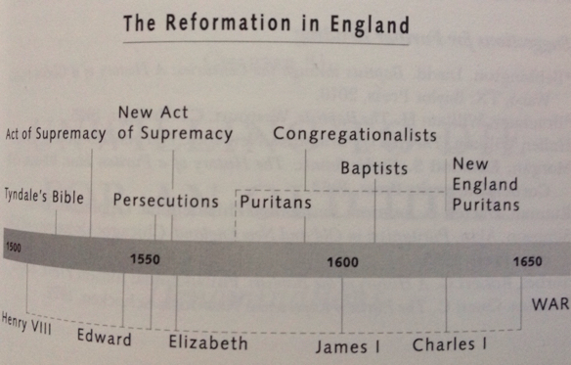

Slide 3
The Church of England
2 reformations - constitutional and theological
Constitutional reformation was mainly about succession to the throne.
Players -
King Henry VIII
Queen Catherine of Aragon, 1st wife of Henry
Anne Boleyn - Court lady in waiting, 2nd wife of Henry
Cardinal Thomas Wolsey - Archbishop of York, Cardinal of the Church of Rome, Chancellor of the English realm
Thomas Cromwell - Protestant sympathiser, son of a blacksmith, chief advisor to Wolsey and chief minister to Henry
Thomas Cranmer - Protestant sympathiser, advisor to Henry, Archbishop of Canterbury
Pope Julius II
Pope Clement VII
Earl of Norfolk Suffolk
Sir Thomas Moore - Chancellor of the English realm
Jayne Seymour - lady in waiting, 3rd wife of Henry
William Tyndale - biblical translator
Miles Coverdale - biblical translator/compiler
John Rogers - biblical translator/compiler

Slide 4
Church of England continued
1521 AD - Henry was bestowed the title Defender of the Faith.
1525 AD - The Curse - Lev 20:21 - Anne was 40.
1526 AD - Tyndale started smuggling the 1st edition of his translation of the NT into England.
1527 AD - Henry requests an annulment from Clement.
1530 AD - death of Wolsey.
Cranmer suggests Henry approach the European universities for their opinion.
1533 AD -
January - Henry secretly marries Anne.
May - Henry obtains an annulment for his marriage to Catherine from a church court headed by Cranmer.
June - Anne is crowned queen.
September - Anne gives birth to Elizabeth, but English nobility are reticent to accept a queen after the bloody battles in the wake of Empress Matilda 1114 AD => Clement excommunicates Henry.
1534 AD - parliament issues the Act of Supremacy and the Church of England is born (Angelicana Ecclesia).
Tyndale partially translates the OT into English.
1535 AD - under Lord Cromwell Coverdale publishes his translation of the Bible - mainly Tyndale's work and sections from Latin and German bibles.
1536
Henry suppresses the monasteries.
Tyndale falls is captured by church officials and imprisoned for 17 months. He is burned at the stake and his dying prayer was, "Lord, open the king of England's eyes."
1537 AD - John Rogers publishes the Matthew Bible based on Tyndale's and Coverdale's work (the Great Bible).
1539 AD - Cranmer requested of Henry that he authorise the Great Bible to be bought and read throughout the realm. Cranmer also makes a contribution to the Book of Common Prayer.

Slide 5
Church of England continued
Legacy - Out of the C of E came the Puritans, and later, other Christian groups; such as Congregationalists, Baptists, Presbyterians, Independents, Quakers, Levellers, etc.

Slide 6
Church of England continued
Theological reformation mainly consisted of a compromise between Roman Catholicism and Protestantism, 'the best of both worlds', the Via Media, the Middle Way
Players -
King Edward VI (aged 10), I son of Jayne Seymour
Queen Mary I of England, Queen Mary of Scotland (Bloody Mary), daughter of Catherine of Aragon
Queen Elizabeth I, daughter of Anne Boleyn
Oliver Cromwell and the New Model Army
1547 AD - Henry died - Edward replaces him
Out of the C of E came the Puritans, and later, other Christian groups; such as Congregationalists, Baptists, Presbyterians, Independents, Quakers, Levellers, etc.

