Slide 1
Church History
The age of the reformation (1517 – 1648 ad)
By Jose Guerra 6 Oct 2016
Church History Team - 0verseer: Pastor Ray Poutney

Slide 2
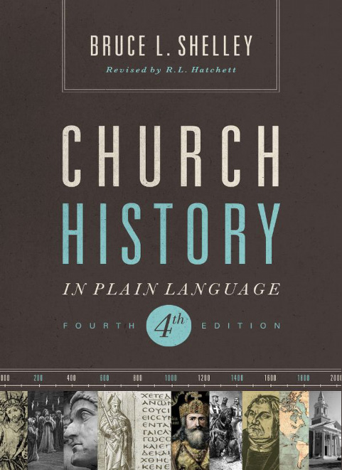
Primary Source Material

Slide 3
Agenda
Define the lesson timeline for the session
Review Resource page on EHBC website
Terms and definitions
The Age of the Reformation

Slide 4
Terms
Predestination – to determine beforehand
Transubstantiation – the conversion of the substance of the Eucharistic elements into the body and blood of Christ at consecration, only the appearances of bread and wine still remaining.
Protestantism – a “modification of Catholicism” in which Catholic problems remain but different solutions are given. The four questions that Protestantism answered in a new way are:
How is a person saved?
Where does religious authority lie?
What is the church?
What is the essence of Christian living?

Slide 6
Quote of the Day
“The spirit of reform broke out with surprising intensity…giving birth to Protestantism and shattering the papal leadership of western Christendom. Four major traditions marked early Protestantism: Lutheran, Reformed, Anabaptist, and Anglican…a few pioneers pointed toward a new way: the denominational concept of the church.”
Shelley, Dr. Bruce L.. Church History in Plain Language: Fourth Edition (p. 245). Thomas Nelson. Kindle Edition.

Slide 7
Last Week in Church History
The Christian Middle Ages
The rise of powerful Popes
The rise of Islam
The Holy Crusades
The East-West Schism
The corruption of the church and the Popes
The Great Papal Schism
The rise of Scholasticism (schools and universities)
Lead to free thinking and questioning

Slide 8
Translation of the Bible
The Bible was originally written in Hebrew, Aramaic and Greek.
It was first translated into Latin by Jerome in the early 400’s.
He produced the Latin Vulgate (Vulgate meaning common language)
Some early Christian leaders were against it.

Slide 9
Issues of the Day
Dominion or Lordship over men – arose from God, but how was lordship transmitted from God to earthly rulers?
Derived only from the Roman Church?
Had to be in a state of Grace, committed no grievous sin.
Any authority exercised by sinful rulers was unlawful.

Slide 10
John Wyclif (1300 – 1384)
The English reformer, who denounced the worldliness of the popes and emphasized the spiritual freedom of the righteous man.
What Wyclif believed:
The English government had the divinely assigned responsibility to correct the abuses of the church within its realm and to relieve of office those churchmen who persisted in their sin. The state could even seize the property of corrupt church officials.
The spiritual freedom of the righteous man
In a personal relationship between man and God
The pope was the AntiChrist
The principle of falsehood
Labours for worldly magnificence and luxury
Seeks temporal dominion
Christ is the head of the church
The church on earth he defines as the whole number of the elect, containing “only men that shall be saved.” (Predestined)
Absolute predestination: no man knows if he is saved or not
He judged the Roman Church based on the Scriptures “Christ’s Law”
Every man has the right to examine the Bible
Translated the Latin Bible into English for the common man
Taught against transubstantiation

Slide 11
John Hus (1300 – 1384)
The Czech reformer, viewed Christ, not the pope, as the head of the church.
Was a student of Wyclif and promoted his ideas in Prague
He attacked the pope’s sale of indulgences
He was excommunicated and captured by the Inquisition
Created a large following in Bohemia

Slide 12
Martin Luther (1483 – 1546)
Was the father of the Reformation, which transformed not only Christianity but all of Western civilization.
Justification by faith alone (the cross alone can remove man’s sin)
The Roman Church taught justification through faith and good works (James 2)
Intersession of priest or church is no longer needed
Published his 95 Thesis against indulgences and was spread by the printing press
Challenged the pope and the church stating that they can error and that they cannot establish articles of faith, they can only come from Scripture
1. Salvation was through faith in Christ alone
2. The Scriptures are the standard for Christian faith and behaviour
Translated the Bible into German
His new movement spread from town to town, priests and local people removed statues from churches and abandoned the mass
He abolished the position of bishop because it was not found in Scripture
He encouraged monks and nuns to marry giving rise to the married pastor
His teachings helped establish the State Church in Germany

Slide 13
The Anabaptist
Goal: restitution of the Apostolic Church
Believed in the separation of Church and State (not found in Scripture)
Did not believe in child baptism (non-Scriptural)
Believed that the individual had to choose to be part of the Church and baptise
Believed you could not be born into the church
They were pacifists
Believed that everyone is equal both men and women
7 principles:
Baptism can only be ministered to those that believed
3 strikes and you are out, if you continue to sin you are out of the community
Communion should only be given to people that have been baptised as adults
True believers cannot associated with those that are not united with God or Christ
Believers should shun all creatures that are banned
The giving of oaths must be rejected
Use of the sword must be rejected

Slide 14
John Calvin (1509 – 1664)
Father of the Reformed Reformation
Calvin wanted to start from scratch whereas Luther wanted to modify Catholicism
Wrote “Systematic Theology” – writes doctrines and theology (founded upon logic)
The sovereignty of God, he is in control of everything
The doctrine of predestination (The elect) these people do not have free will
The 5 points of Calvinism:
Total depravity (humans are sinful)
Unconditional Election (God chooses his people)
Limited Atonement (only for the elect)
Irresistible Grace (cannot resist)
Perseverance of the Saints (You cannot lose your salvation)
Iconoclasm – the removal of statues and paintings
Clothing – dressed plainly, did not believe in ornamentation
In England they became Puritans

Slide 15
The Church of England
King Henry VIII gave birth to civil-religion
He rejected the authority of the Roman Catholic Church
He made religion a private affair
Religion became an instrument of the state
He established the Anglican Church where the King is the head of the church “Defender of the Faith”
He authorized the publication of the Bible in English based on the Greek and Hebrew

