Slide 1
Themes in Old Testament Theology
A book by William Dyrness
By Jose Guerra 17 Nov 2016
Church History Team - 0verseer: Pastor Ray Poutney

Slide 2
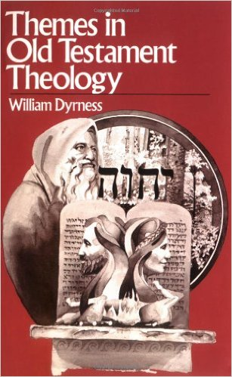
Source Material

Slide 3
Critical Thinking Question
What is the central element of the Old Testament?
“…the whole is best expressed as God’s creative-redemptive self-revelation, or in simpler words, his bending down to be a father to his people” – William Dyrness

Slide 4
Themes in the Old Testament
The Self-Revelation of God
The Nature of God
Creation and Providence
Man and Woman
Sin
The Covenant
The Law
Worship
Piety
Ethics
Wisdom
The Spirit of God
Prophecy
The Hope of Israel

Slide 5
Summary of Themes
The nature of God leads him to relate himself to men and women in the covenant
The law fills out the covenant
The cult (formal worship) and piety grow together out of the covenant
Christ seals the covenant with his death

Slide 6
The Self-Revelation of God
Gen 12 – God calls Abraham to leave his country and his people (God does not identify himself)
Gen 15 & 17 – God establishes his covenant with Abraham (God identifies himself as El Shaddai)
Exodus 3 – God appears as the “angel of the Lord”
Exodus 6 – God identifies himself to Moses as, “I am the Lord”
Exodus 19/20 – God says to Moses, “You have seen what I did”

Slide 7
The Nature of God
God is Personal – God gives himself a name, he offers himself in fellowship. To know his name is to have a personal relationship with him.
God is Spirit – meaning wind or breath, He is the source of life.
God is One: Monotheism – “…The Lord our God is one Lord” Deut 6:4
The Power of God – all the works of God display his power

Slide 8
Creation and Providence
By Word and Work – God created the world by his word and at the same time by his direct intervention.
Ex Nihilo – God created the world out of nothing
The Character of Creation – God is the first to admire his creation and call it good
God’s continuing Relationship to Creation – God completes his creation and continues to care for it

Slide 9
Man and Woman
A Special Relationship to Creation – Man and woman are the crown of creation, they are made to rule
The Special Relationship among Persons – God created persons man and woman, persons were made to love
A Special Relationship to God – man and woman are called to a higher end: to love their creator
“…the human race: created in the weakness of flesh from the dust, but with the capacity and appetite for God” – William Dyrness

Slide 10
Sin
Origin of Sin: The Fall
Boundary of Fellowship – a person’s created nature represented no barrier to fellowship with God
Breaking f Fellowship – Sin enters by a free decision of Adam and Eve
Protection of Fellowship – Sin must be judged but judgement is always mixed with mercy
The Result of Sin
Guilt – the condition of liability to punishment at God’s hand, the state of deserving God’s wrath
Punishment – punishment follows to the certain response to sin

Slide 11
The Covenant
“I will establish my covenant with you…”
Covenant with Noah
Covenant with Abraham
Mosaic Covenant
Covenant with David

