Slide 1
Church History
Review the first 300 years
By Jose Guerra 15 Sept 2016

Slide 2
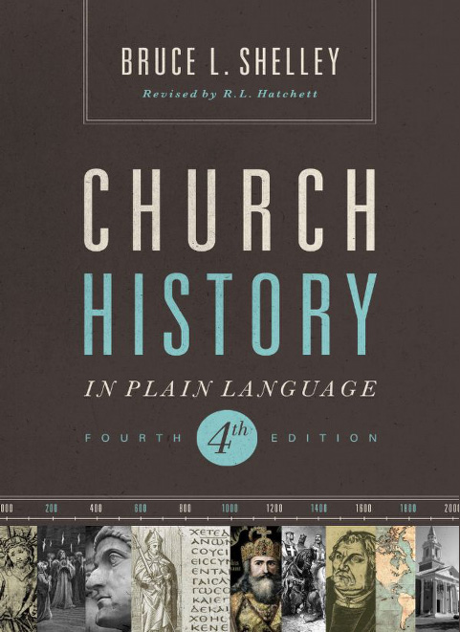
Primary Source Material

Slide 3
Agenda
Hand out history outlines
Define the lesson timeline for the session
Review Resource page on EHBC website
Review Terms
Review the first 300 years of Church History

Slide 4
Non-Trinitarian Christian Views
Gnosticism – the belief that matter is evil and that salvation (emancipation from the world) is attained through secret knowledge, spiritual truth or wisdom
Marcionism – a branch of Gnosticism, accepting part of the New Testament, believing that the World is evil and the God that created it must also be evil. Thus, the Old Testament God is evil and the New Testament God is good. Also denying that Jesus took human form.
Arianism – the doctrines which undermine the divinity of Jesus, believing that he is not of the same substance as the father and is subordinate or a created being.

