Slide 1
Church History
The Age of the Christian roman empire (312 – 590 ad)
By Jose Guerra 22 Sept 2016

Slide 2
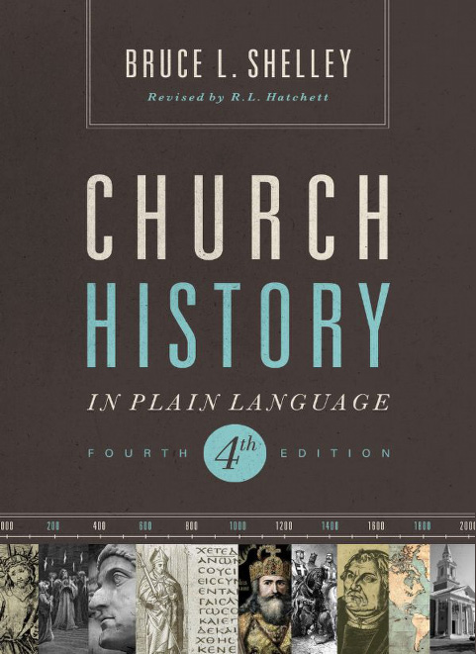
Primary Source Material

Slide 3
Agenda
Hand out outlines
Define the lesson timeline for the session
Review Resource page on EHBC website
The Age of the Christian Roman Empire

Slide 5
Quote of the Day
“…under the instruction of Constantine, the church refined its doctrine and developed its structure. Some, such as the historian Eusebius, saw Constantine’s embrace of Christianity as its victory over the empire. Others, such as the monks, believed the culture was capturing Christianity.”
Shelley, Dr. Bruce L.. Church History in Plain Language: Fourth Edition (p. 95). Thomas Nelson. Kindle Edition.

Slide 6
The Conversion of the Empire
The importance of Diocletian in saving Rome
The rise of Constantine “In this sign conquer”
He favoured Christianity openly
He allowed Christian ministers to be tax exempt
He abolished execution by crucifixion
Halted gladiator battles as a punishment for crimes
In 321 AD he made Sunday a public holiday
He supported the building of churches
His children were raised as Christians
He was baptised in 337 AD before he died
Notes:
Diocletian was a soldier elected to be emperor. He saved a crumbling empire by dividing it and splitting power. Prior to this Caesars would kill previous rules in order to ascend. This put heirs in danger and in line to be executed.

Slide 7
Negative Aspects of the Conversion
The Church and the State shared power
The hierarchy was God then Emperor
Many people converted for political reasons
People who were still have rooted in paganism
Produced secularisation and misuse of religion
Powerful bishops could challenge Emperors via excommunication i.e. Theodosius vs Ambrose
Notes:
Diocletian was a soldier elected to be emperor. He saved a crumbling empire by dividing it and splitting power. Prior to this Caesars would kill previous rules in order to ascend. This put heirs in danger and in line to be executed.

Slide 8
The Doctrine of the Trinity
Rejected Trinitarian Schemes
Monarchians – one great ruling God
Modalism – God taking on different forms
Subortinationism – one great God and two lesser gods
Bishop Arius argued, “the son has a beginning, but…God is without beginning”
The Council of Nicaea was called to settle Jesus’ divinity
“True God of true God, begotten not made, of one substance with the Father.”
For the next 50 years there was a struggle between Arianism and Orthodoxy (Athanasius defender of the faith)
If man is created in the image of God then man is created in the image of the Trinity
“God in three persons, blessed Trinity”

Slide 9
Christ in the Creeds
Jesus Christ was “complete in Godhead and complete in manhood, truly God and truly man . . . in two natures, without confusion, without change, without division or without separation . . . coming together to form one person.”
The God-man
The Word became flesh
Christology – Who is Jesus?
Two schools of thought (Alexandrian vs Antioch)
The Word assumed human flesh (humanity in general)
The Word was joined to the man named Jesus
The meaning of the event (Word became flesh) raged for generations
Son of God and son of Mary
God could be born of a woman
God could be three days old

Slide 10
The Beginnings of Monasticism
John the Baptist, Jesus and Paul hinted at it
It emerged soon after the Apostolic Age
Monks renounce the comforts of society and seek the spiritual rewards of self-discipline
Anthony the first monk (250 AD)
Monasticism has been debated for centauries
Monasticism encourages two roads to God, a higher one and a lower one – but the gospel knows only one way to salvation

Slide 11
Augustine
He struggled between his higher nature and his temptations
Donatist vs Catholic bishops (unworthy bishops)
Augustine rejected the idea of a pure church, until the day of judgement the church must be a mixed multitude
He taught the concept of original sin where some bishops (Pelagius) opposed it
He wrote the City of God after Rome was sacked by barbarians

Slide 12
The Beginning of the Papacy
Papacy is highly controversial
The Vicar of Christ
The Anti-Christ
According to the Roman Catholic Church Jesus Christ established the papacy with the apostle Peter
Peter as “Pontifex Maximus”
The bishop of Rome as Peter’s successor
Peter and Paul referred to as founders of the Church in Rome
Over time the Church in Rome became the leader of the churches
As the Roman Empire declined the Roman Church grew in power
Bishop Leo was a key figure in the start of the papacy
Attila the Hun and the Vandals (he negotiated for Rome)

Slide 13
Eastern Orthodoxy
What is Eastern Orthodoxy?
The importance of icons
They are not man made but manifestations of the heavenly ideal
“In Orthodoxy the idea of image is the key to understanding the ways of God with man. Man is created “in the image of God”; he carries the icon of God within himself.” – Shelley, Dr. Bruce L.. Church History in Plain Language: Fourth Edition (p. 152). Thomas Nelson. Kindle Edition.
When man sins, he reduces the divine, inflicts a wound on the original image of God
Salvation consists on the perfection or completion of the full image

Slide 14
Mission to the Barbarians
476 AD marked the end of the Christian Roman Empire in the West
Barbarians (mainly Germans) from the north brought and end to the Roman Empire (west)
Germans fought Germans for leadership
Missionary monks overthrew barbarian magic by calling down superior powers
Conversion came when the Barbarians surrendered their gods
They converted directly from paganism or indirectly through Arianism

